Slide 1

Hello and welcome . In this presentation .I will take you through our company's sales performance for the year 2010 and 2011
I appreciate the opportunity you gave me to dive into this data to gain insightful about the store's performance.
Thankyou also for the question you asked since they provide a general direction for the kind of insight you are looking to get from this analysis.

Slide 2

I assure you that I look all the necessary steps to ensure that this analysis value in the unit Price and Quantity column and also filtered the data as required for all the visualization.
I cleaned up the data you provided by removing the negative values.

Slide 3
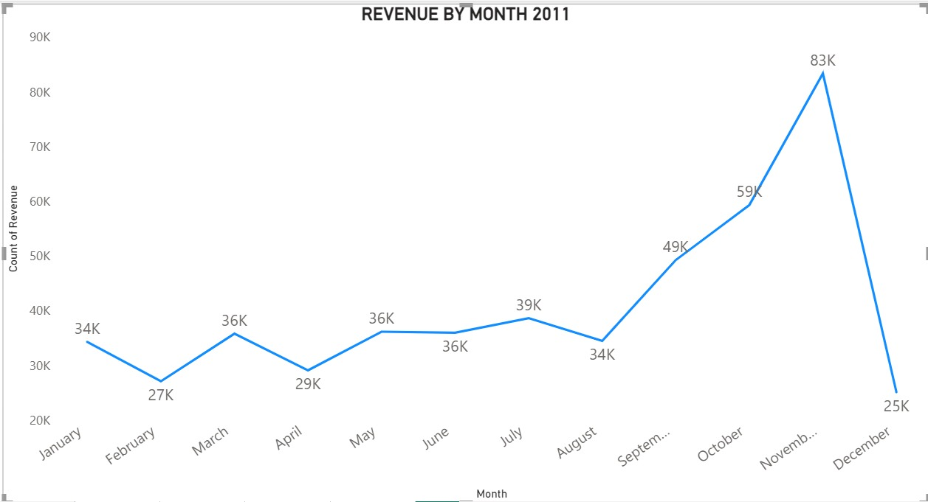
The line chart displays the revenue by month for 2011, highlighting a steady fluctuation throughout the year. The revenue peaks sharply in November at 83K, followed by a significant drop in December to 25K, indicating a seasonal impact on revenue performance.

Slide 4
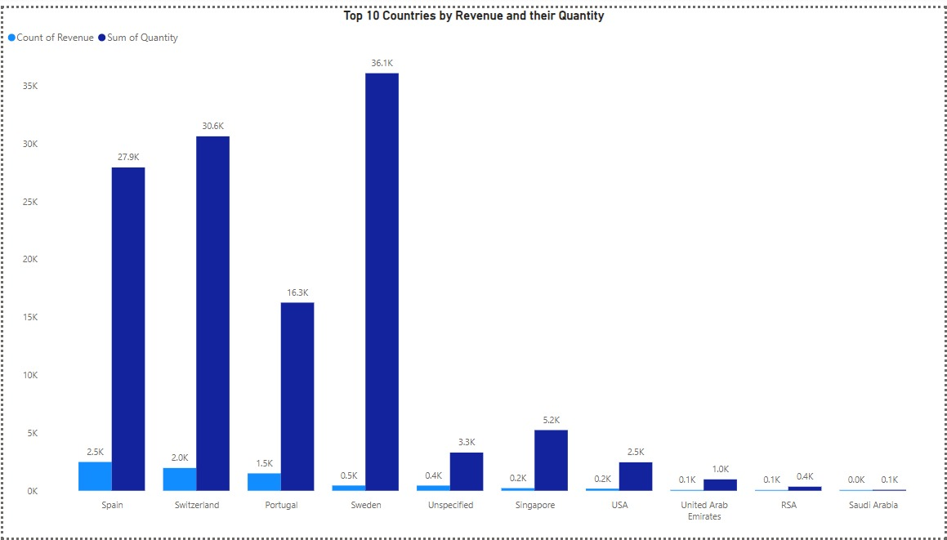
The chart compares the top 10 countries by revenue and quantity, highlighting that Sweden leads with the highest revenue at 36.1K, despite having a lower quantity than other countries like Spain and Switzerland. The data shows a significant variation in revenue generation relative to quantity across different countries.

Slide 5
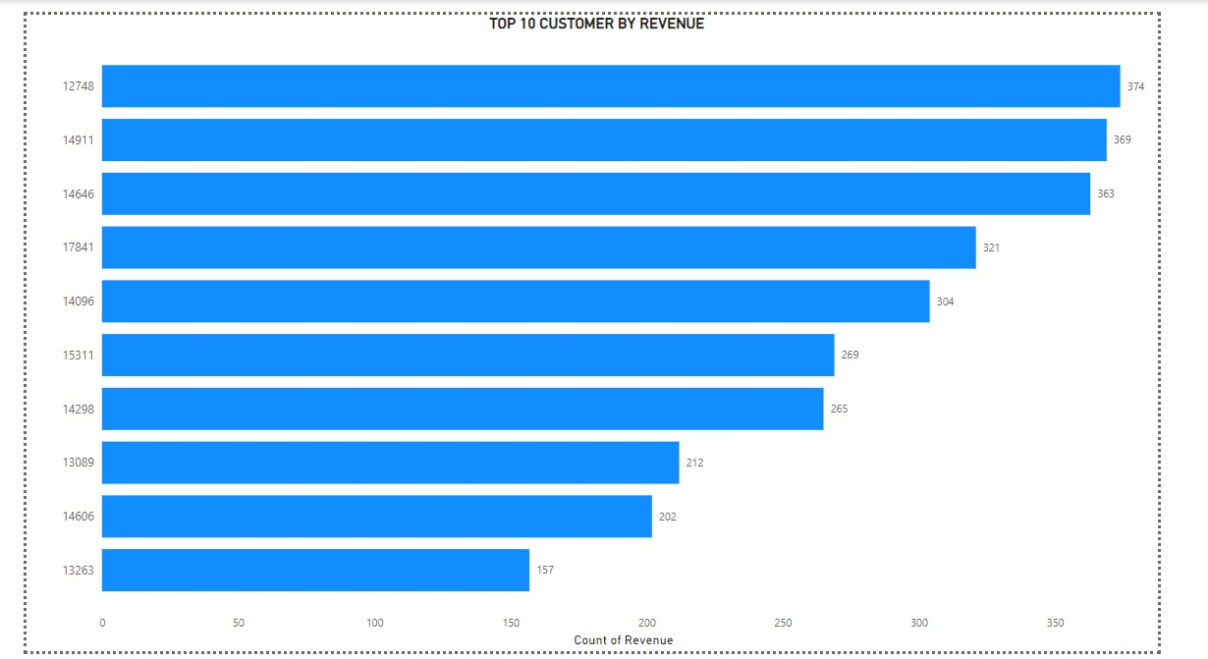
The chart shows that there is no major difference the top 10 Customer in terms of revenue generated.
The Company can aim to strength the relationship with these customer to increase customer loyalty and retention and ultimately drive more sales and revenue for the company.

Slide 6
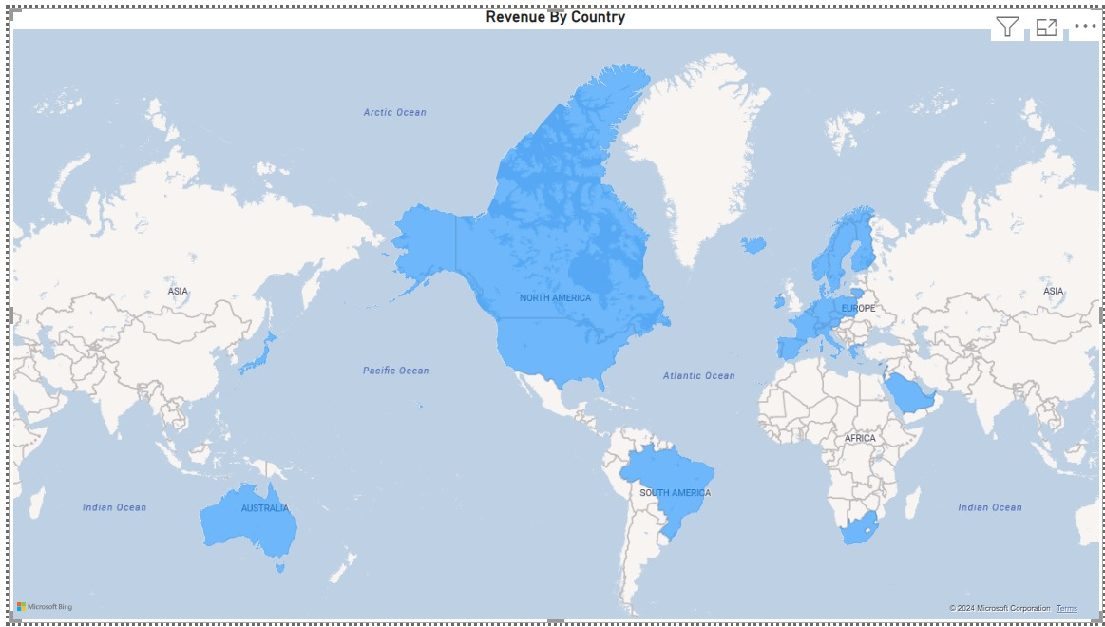
The map chart concludes by comparing the places that have product the greatest revenue to those that have not. The map also reveals that the majority of sales occur only in the European zone, with only a small number in the American region. Along with Russia there is no market for the items in Africa or Asia.
The company can concentrated on the European market more and drive deeper into countries in the region to come up with strategies that will maximize sales from each country in the region alongside Australia and Japan.

Slide 7

The Company can aim to strength the relationship with these customer to increase customer loyalty and retention and ultimately drive more sales and revenue for the company.
The company should come up with strategies that sim at stocking and advertising seasonal products to maximize sales when demands for these goods goes up.
The company should do a deeper analysis of products that are usually in high demand during low-sales months to come -up with strategies for marketing these products.
The European Market has more potential for growth and the company should aim at strategies that will increase its market positioning in the region.

